Slide 1

Burikantu Shopping Web Application
Welcome to the presentation on the Burikantu Shopping Web Application. This project is meticulously designed to offer users an intuitive and efficient online shopping experience, encompassing everything from product browsing to secure order placement. Our goal is to create a seamless digital storefront that simplifies e-commerce for both customers and administrators.

Slide 2
Project Overview and Vision
Seamless User Experience
Core Functionality
The Burikantu Shop App is an e-commerce web application meticulously crafted to provide a smooth and engaging experience. Its design prioritizes ease of use, allowing customers to effortlessly browse, manage, and purchase products with minimal friction.
This application supports critical e-commerce features including robust user authentication, comprehensive product catalog management, and streamlined order placement. These functionalities ensure a complete and satisfactory shopping journey from start to finish.
Our vision for the Burikantu Shop App is to establish it as a leading platform for online retail, distinguished by its user-centric design and powerful underlying technology. We aim to empower businesses to reach their customers effectively and provide consumers with a reliable and enjoyable shopping environment.

Slide 3
Underlying Technologies
Backend: Asp.NET Core Web API
Database: SQL Server
The server-side logic for the Burikantu Shop App is powered by Asp.NET Core Web API. This robust, .NET-based framework is selected for its high performance, scalability, and security features, enabling efficient handling of complex business operations and API requests.
All critical data for the application, including user information, comprehensive product details, order history, and payment data, is securely stored within SQL Server. This relational database management system ensures data integrity, rapid retrieval, and robust security for all transactions.
The strategic choice of these technologies ensures a powerful, scalable, and secure foundation for the Burikantu Shop App. Their integration facilitates seamless data flow and reliable performance, crucial for a modern e-commerce platform.

Slide 4
Key Business Objectives
1
Product Browsing
2
User Management
Users are empowered to view a diverse array of products, efficiently search for specific items using intuitive filters, and seamlessly explore various product categories to discover new offerings.
Customers can effortlessly create new accounts, securely sign in to existing ones, and manage their personal profiles, ensuring a personalized and secure shopping experience.
3
Order Management
4
Security
Once desired products are selected, users can easily place orders and gain full visibility into their order status, from processing to delivery, ensuring transparency and peace of mind.
User credentials are safeguarded through robust encryption and authenticated using a secure framework, ensuring the highest level of data protection and privacy for all users.
These objectives are fundamental to delivering a premium online shopping experience. They are designed to cater to the diverse needs of users while maintaining a secure and efficient operational backend.

Slide 5



Comprehensive Application Features
User Authentication
Product Management
Order and Cart Features
Admin Features
Administrators gain access to a centralized dashboard for managing users, products, and orders, ensuring efficient oversight and control over the entire e-commerce ecosystem.
The application supports secure user authentication with distinct processes for new registrations and existing user logins, ensuring personalized access and data protection.
Users can easily view detailed product descriptions, pricing, and availability. An efficient search function allows discovery by name or category, enhancing the shopping experience.
Customers can intuitively add products to their shopping cart, manage cart items, and proceed to place orders with a streamlined checkout process.
Each feature is designed to contribute to a fluid and comprehensive e-commerce environment, catering to both the end-user's shopping needs and the administrator's operational requirements.

Slide 6
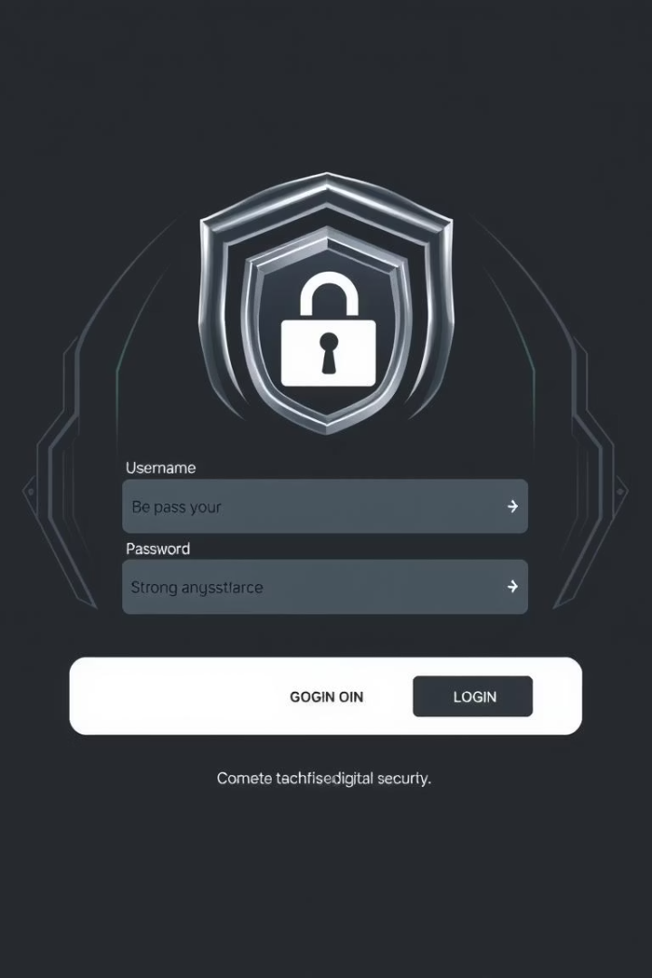


User Authentication Flow
Sign Up (Create Account)
New users navigate to the dedicated "Sign Up" page. They provide their name, email address, and a secure password. Upon submission, a new account is created, and the user is redirected to the login page for their first sign-in.
Sign In (Log In)
Registered users access the "Sign In" page. They input their registered email address and password. Upon successful authentication, they are granted access to their personalized account dashboard, where they can browse products and manage orders.
This structured authentication process ensures that user accounts are securely managed, providing both convenience for the user and protection for sensitive data. It is a critical component of the application's overall security architecture.

Slide 7




E-commerce Value Chain
Product Sourcing
Catalog Management
Acquiring goods from suppliers, ensuring quality and availability for the catalog.
1
Maintaining up-to-date product information, pricing, and inventory levels.
2
Fulfillment & Delivery
Order Processing
4
Ensuring timely and accurate delivery of products to the customer's doorstep.
Handling customer orders, from payment confirmation to picking and packing.
3
Understanding the e-commerce value chain is crucial for optimizing operations and enhancing customer satisfaction. Each step is interdependent, contributing to the overall efficiency and success of the Burikantu Shop App.

Slide 8

Development Journey and Milestones
1
Phase 1: Planning & Design
Defining project scope, gathering requirements, and initial architectural design. Focus on user flows and database schema.
2
Phase 2: Core Feature Implementation
Development of user authentication, product display, and basic cart functionality. Backend API development initiated.
3
Phase 3: Advanced Features & Admin Tools
Integration of order management, search capabilities, and admin dashboard. Enhancements to user profiles.
4
Phase 4: Testing & Deployment
Comprehensive testing (unit, integration, UAT), bug fixing, and preparation for deployment to production environment.
Our development journey follows a structured approach, ensuring that each phase builds upon the last. This iterative process allows for continuous feedback and refinement, leading to a robust and high-quality final product.

Slide 9

Key Takeaways & Future Directions
Robust Foundation
The Burikantu Shop App is built on a solid foundation of Asp.NET Core and SQL Server, ensuring scalability, performance, and security for future growth.
User-Centric Design
All features, from authentication to order management, are designed with the user in mind, providing an intuitive and seamless shopping experience.
Continuous Improvement
Future enhancements will include advanced search filters, personalized recommendations, and integration with third-party payment gateways to enrich the platform.
The Burikantu Shopping Web Application stands as a testament to thoughtful design and robust development. We are committed to its continuous evolution, ensuring it remains at the forefront of e-commerce innovation and user satisfaction.

